Slide 1
MD5
designed by Ronald Rivest (the R in RSA)
latest in a series of MD2, MD4
produces a 128-bit hash value called Message Digest (MD)
Notes:
MD5 is the current, and very widely used, member of Rivest’s family of hash functions.

Slide 2
MD5 Logic
1.Append padding bits 10…0 (1 to 512 bits)
2.Append length of original message
3. Initialise Message Digest Buffer: A B C D
4. Process message in blocks
5. Output hash value

Slide 3
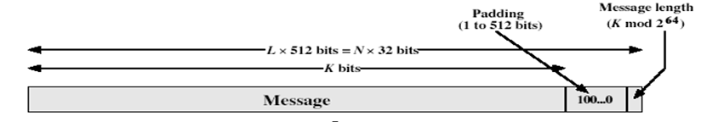
MD5 Algorithm
Append Padding bits. Pad message so that its length is congruent to 448 mod 512.
(i.e., length of the message is = n*512+448).
Padding bits are 100...0
Number of bits padded will be 1 to 512
Padding is mandatory even if the message is having desired length already
Append length of original message in 64 bits format. If length >2 ^64, then apply mod 2^64 to get low-order 64 bits of the length.
Notes:
The padded message is broken into 512-bit blocks, processed along with the buffer value using 4 rounds, and the result added to the input buffer to make the new buffer value. Repeat till run out of message, and use final buffer value as hash. nb. due to padding always have a full final block (with length in it).

Slide 4
3. Initialise MD buffer. Four ‘32’ bit registers (A,B,C,D) are used to store 128-bits buffered data. Initialise registers as:
A=67452301
B=EFCDAB89
C=98BADCFE
D=10325476

Slide 5
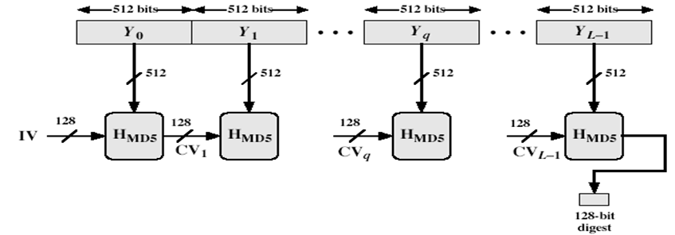
4. Process message in 512-bit blocks:
Divide message into blocks of size 512 bits.
Apply MD5 Compression function (H_{MD5,} round function) on each block.
If Z is the buffer value before applying function and Z’ is the buffer value after applying function, then update buffer as Z+Z’
5. Output. After processing all blocks, output of final block is the message digest of size 128 bits.

Slide 6
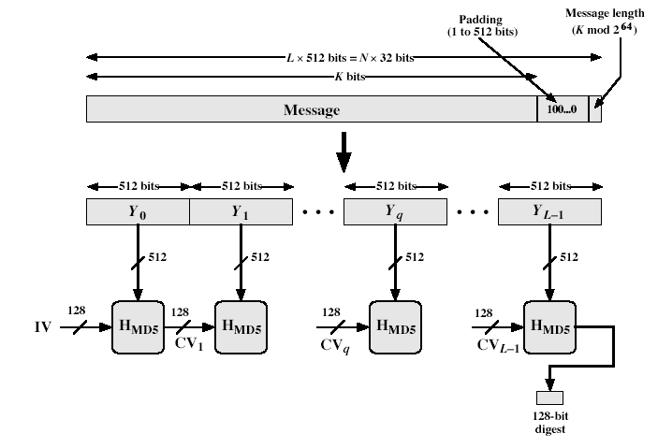
MD5 Overview
Notes:
Stallings Fig 12.1

Slide 7
Compression function (H_{MD5})
Input : message block (512 bits) and buffered data (128 bits)
Output: 128 bits (updated value in buffer)
The compression function has 4 rounds.
Each round uses one of the logical function F,G,H,I and one-fourth of a table T[1, 2,..., 64].
Table T[ ... ] is constructed by using sine function as: T[i]=integer part of 2³² X abs(sin(i)); i is in radians
These entries are random 32 bit numbers which are used to eliminate any regularities present in message.

Slide 8
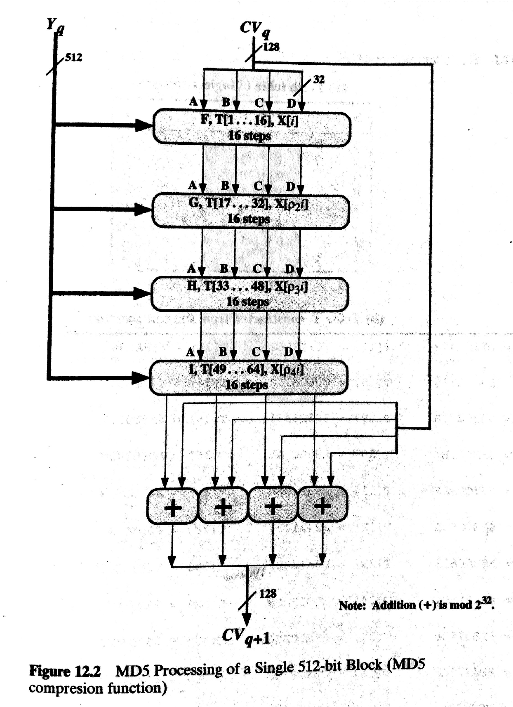

Slide 9
Each round has 16 steps.
Following operations are performed in each step:
A = B+((A+g(B,C,D)+X[k]+T[i])<<<s)
A,B,C,D are the words (registers) of the buffer
g( ) refers to one of the functions: F,G,H,I
T[i] is i^{th} element of table T[1,2,...,64]
X[k] is k^{th} ‘32 bit’ word in input block of message
Remark: This updates only one word of the buffer i.e., A. After 16 steps each word is updated 4 times
Apply circular right shift by one word in buffer
Notes:
Each round mixes the buffer input with the next "word" of the message in a complex, non-linear manner. A different non-linear function is used in each of the 4 rounds (but the same function for all 16 steps in a round). The 4 buffer words (a,b,c,d) are rotated from step to step so all are used and updated. g is one of the primitive functions F,G,H,I for the 4 rounds respectively. X[k] is the kth 32-bit word in the current message block. T[i] is the ith entry in the matrix of constants T. The addition of varying constants T and the use of different shifts helps ensure it is extremely difficult to compute collisions.

Slide 10
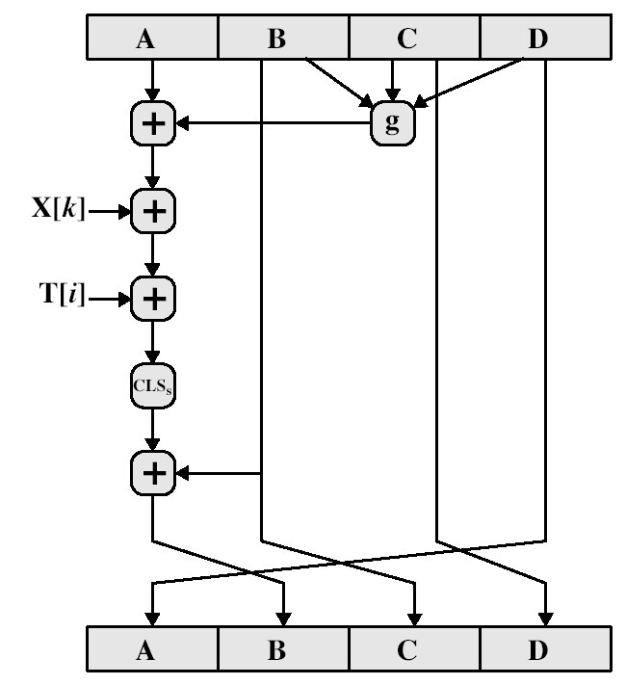
Operations in a step

Slide 11
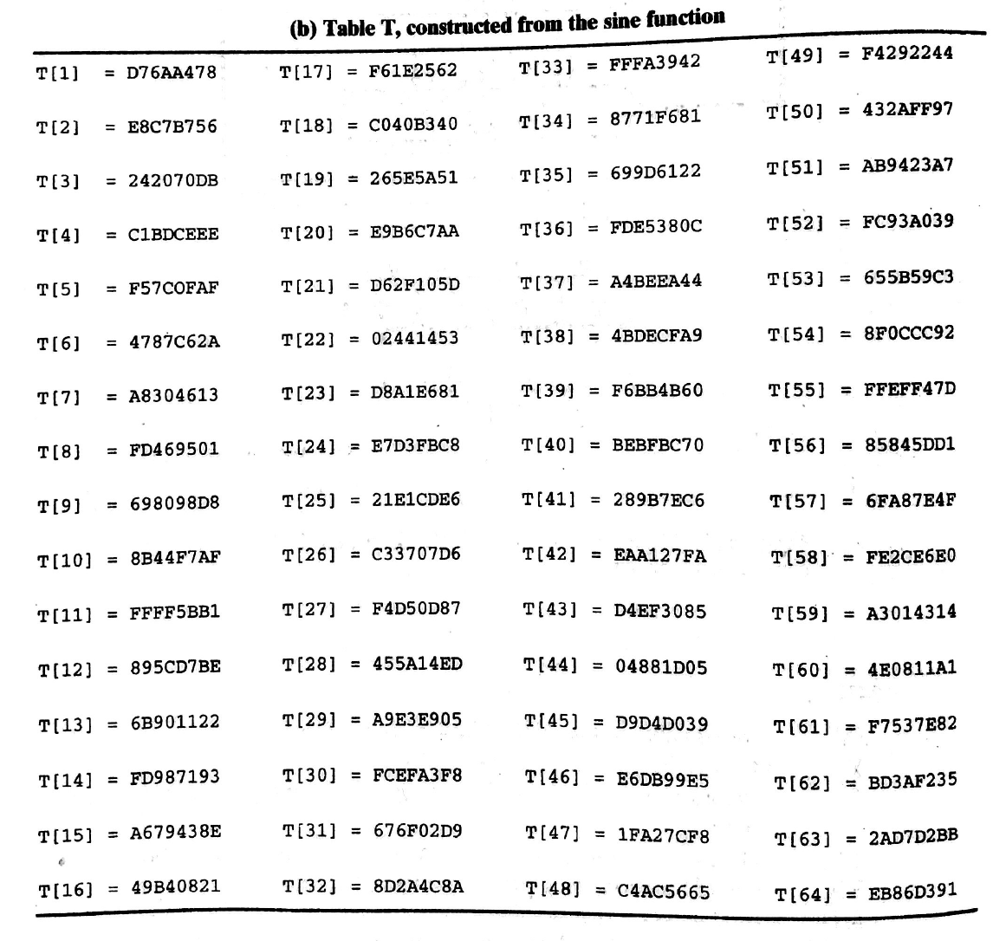

Slide 12
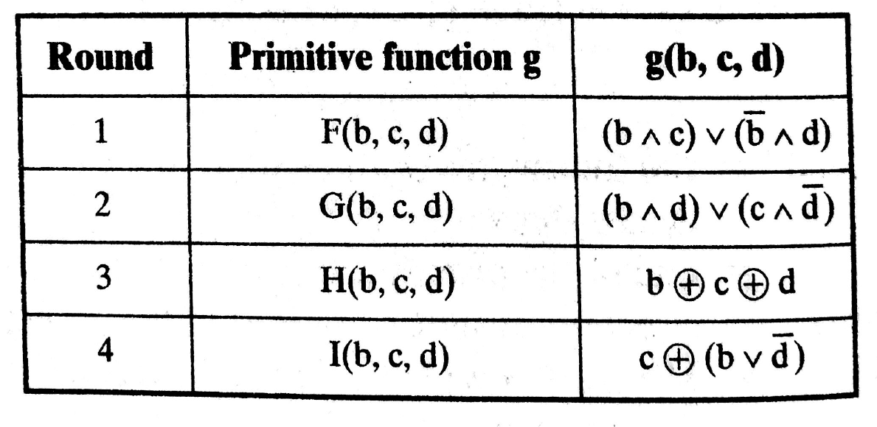

Slide 13
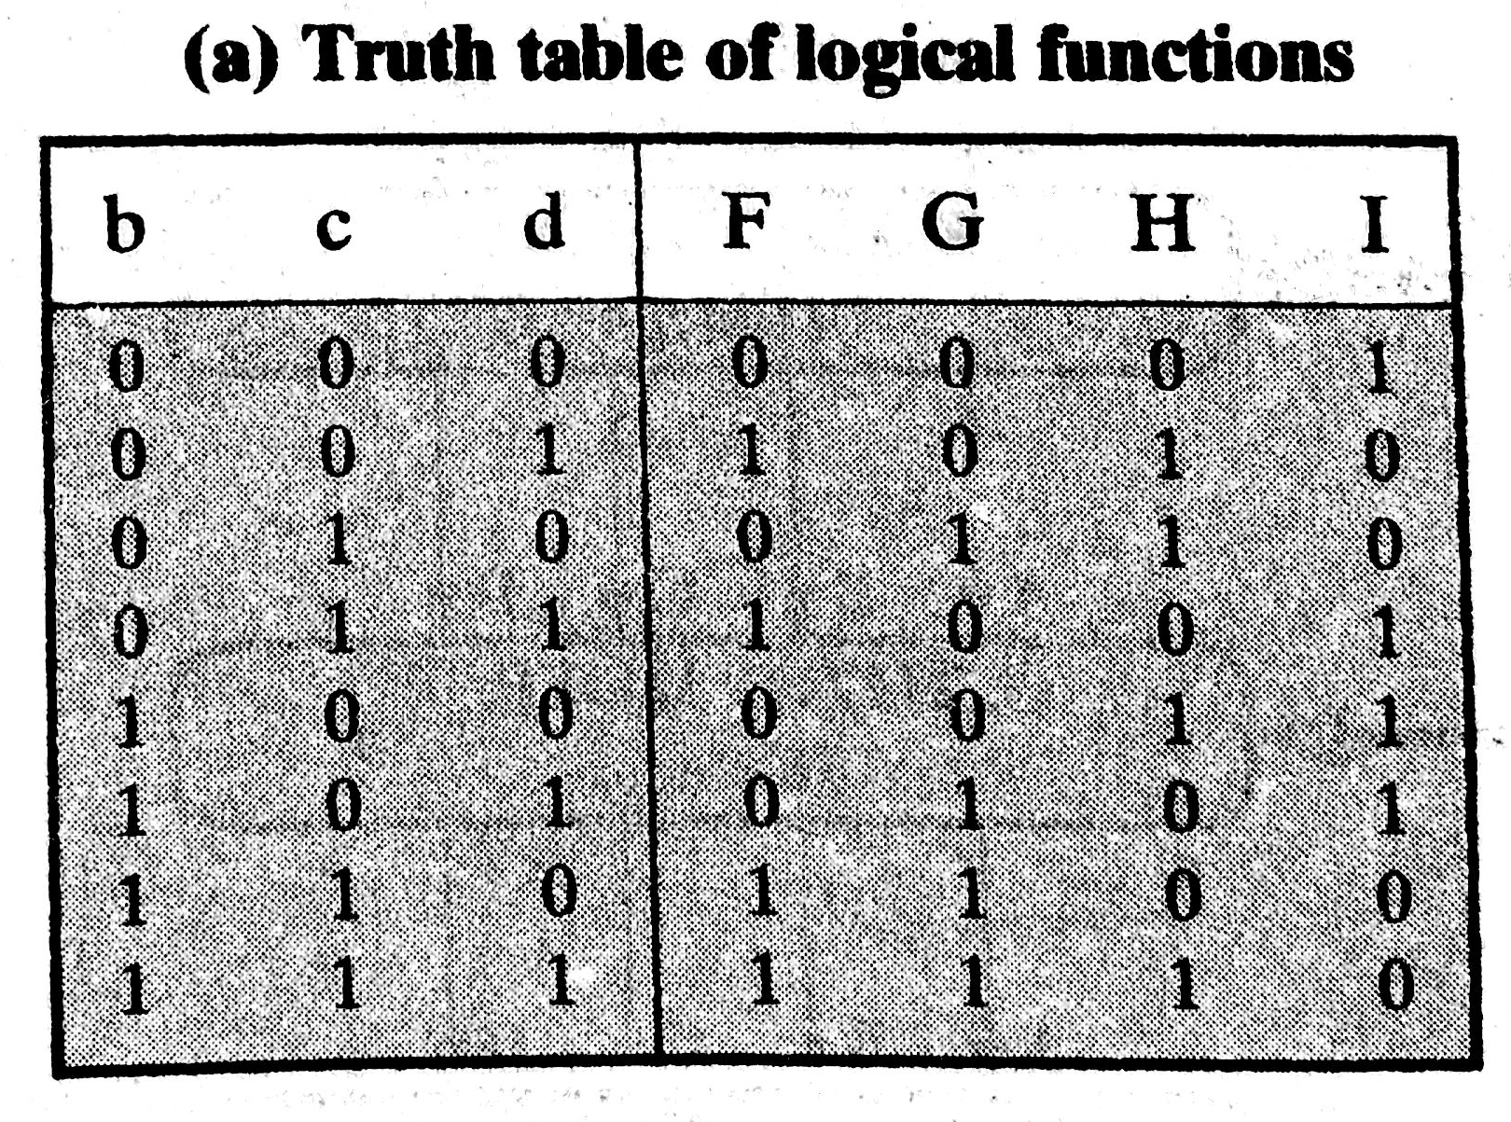

Slide 14
p₂(i)= (1+5i) mod 16
p₃(i)= (5+3i) mod 16
p₄(i)= 7i mod 16

Slide 15
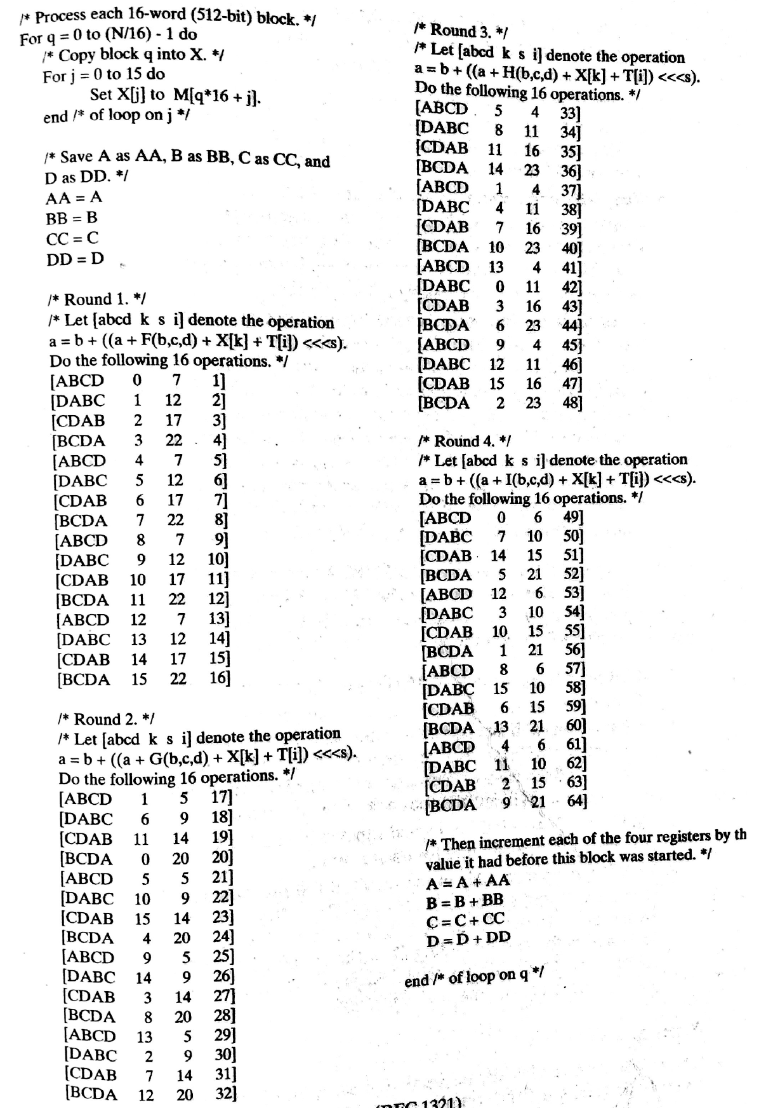

Slide 16
Strength of MD5
MD5 hash is dependent on all message bits
Rivest claims security is good.
known attacks are:
Berson 92 attacked any 1 round using differential cryptanalysis (but can’t extend)
Boer & Bosselaers 93 found a pseudo collision (again unable to extend)
Dobbertin 96 created collisions on MD compression function (but initial constants prevent exploit)
conclusion is that MD5 looks vulnerable soon
Notes:
Some progress has been made analysing MD5, which along with the hash size of 128-bits means its starting to look too small. Hence interest in hash functions that create larger hashes.

